Slide 1
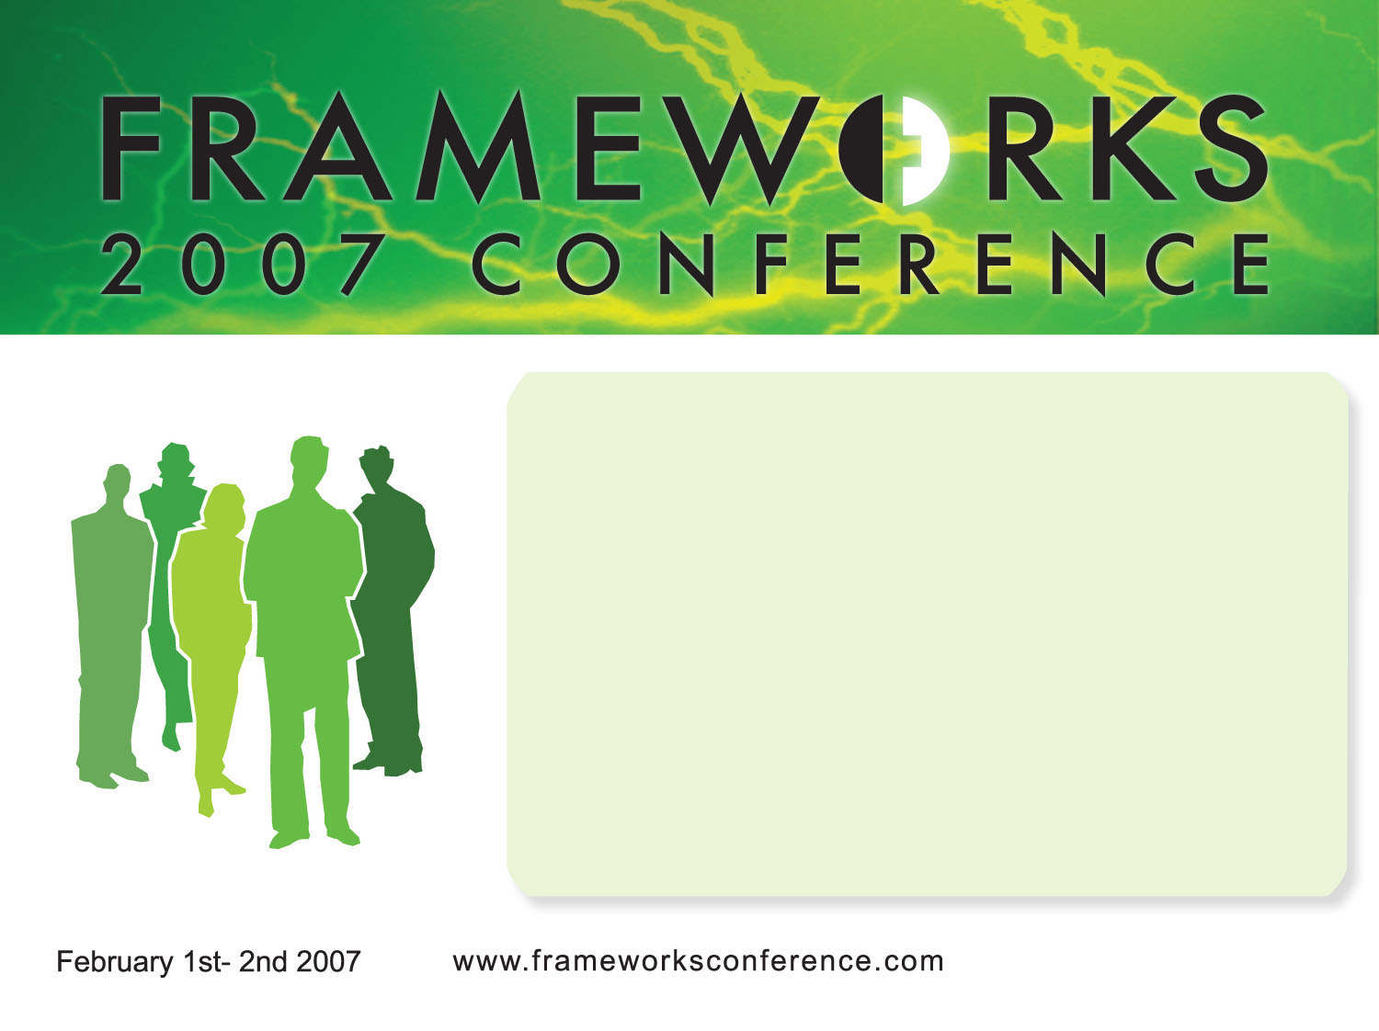
Reactor
An ORM framework for ColdFusion
Presentation By: Doug Hughes
http://www.doughughes.net

Slide 2
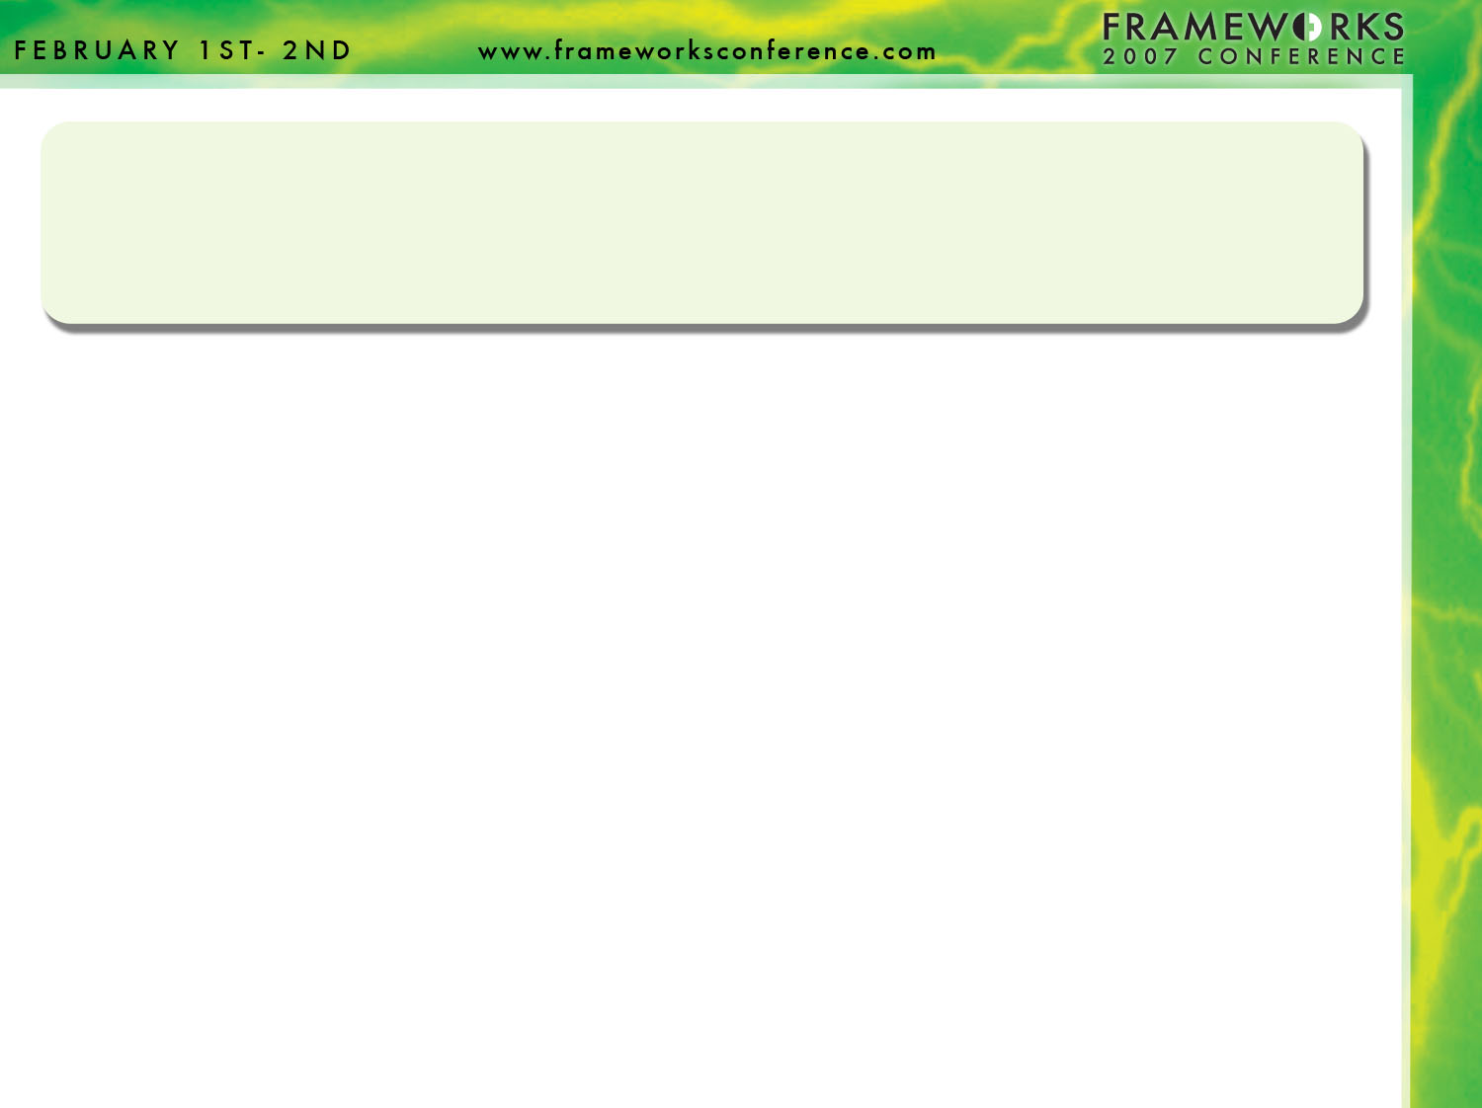
What To Expect…
A quick review of ORM techniques
What Reactor is and isn’t
Supported database servers
The Reactor API (briefly)
Some examples (in code)
Getting Started / Resources
Questions and Answers

Slide 3
How We Used To Do It
<cfquery name="getUsers" datasource="myDSN">
SELECT *
FROM Users
</cfquery>
<cfoutput query="getUsers">
<p>#firstName# #lastName#</p>
</cfoutput>
What’s wrong with this?
  Hard coded DSN
  Query is not reusable
  Mixture of application logic with display
Notes:
What happens if the data source changes?
Answer: You need to find and replace all instances of myDSN.
What if you have another page which runs the exact same query?
Answer: The query is duplicated in both locations. Requires maintenance in both locations

Slide 4
Design Patterns to the Rescue
Data Access Objects (DAOs)
  Provide methods for Creating, Reading, Updating and Deleting a single record.
  Generically called CRUD methods.
Table Data Gateway Objects (Gateways)
  Performs actions on multiple rows in the database.
  Typically gateway methods return record sets.
Active Records
  Newer.
  One object represents one record.
  “Knows” how to read, write and itself from the database.
  Provides getters/setters for modifying data

Slide 5
Some Drawbacks to the New Way
It’s time consuming
  Writing a one-off query only takes a minute
  Writing a series of CFCs (and testing them) takes a lot longer.
It’s verbose
  A typical query is only a few lines of code.
  Adding CFCs into the mix adds a lot of extra CFML
It’s repetitive
  Most CFCs end up looking almost identical.
  Only file, table and column names typically change.
  Leads to a copy-paste-and-edit mentality.
  Leads to subtle bugs, especially in rarely used code.

Slide 6
Database Abstraction Generators to the Rescue!
Many developers end up writing programs to generate this repetitive code.
  May automatically inspect the database (or not)
  Tend to create static files which are manually updated as needed.
This technique has it’s own problems:
  What if you customize an object but later add a new field to your database?

Slide 7
Enter Reactor…
Reactor is coined an “Inline Dynamic Database Abstraction" API.
  Reactor generates objects as needed
  The Reactor API is used in your code.
  Generates objects only as needed (and configured).
  Instantiates objects and returns them.

Slide 8
A Simple Example:
<cfset Reactor = CreateObject("Component", "reactor.reactorFactory").init(expandPath("reactor.xml")) />
<cfset Address = reactor.createRecord("Address") />

Slide 9
What Reactor Is …
Is used to generate ColdFusion objects to access data in your database
Reactor automates much of the repetitive, tedious and error-prone work involved in creating an Object Oriented database abstraction layer.

Slide 10
What Reactor Isn’t …
Reactor is Not Ruby (or ColdFusion) on Rails
  Does not generate application controllers
  No Scaffolding
  Relies on XML, not conventions
Reactor is Not a Panacea
  It does not do everything you need it to!
  You will need to customize some reactor generated objects.

Slide 11
Supported DBMS
Microsoft SQL Server 2000 and 2005
MySQL 4
MySQL 5 and later
PostgreSQL
Oracle 9i and 10g
DB2
Others, too!

Slide 12
Getting Reactor
Subversion
  http://svn.reactorframework.com/reactor/trunk/
DougHughes.net
  http://www.doughughes.net/includes/reactor/reactor1.0BC2.zip
Useful folders:
  /Reactor
  /ReactorSamples
  /Documentation
    From SVN see / Documentation/Documentation/!SSL!

Slide 13
Installing Reactor
Place “/Reactor” in your webroot.
Or…
Make a mapping “/Reactor” to the “/Reactor” folder.
That’s it!

Slide 14
Sample Applications
ReactorBlog
  Used on doughughes.net
Contact Manager
Others…

Slide 15
Some Examples…
I’ll show some examples now
Notes:
Show c

Slide 16
Resources
Documentation
  A work in progress
Trac Site
  http://trac.reactorframework.com
  Roadmap, timeline, tickets, and wiki
DougHughes.net
  My blog – lots of (dated) information there.
  Eventually I’ll create a Reactor-specific section.
Reactor Mailing List
  The best place
  Roughly 300 participants

Slide 17
Questions / Answers

